Slide 1

Electrostatics
Dr. Nameeqa Firdous

Slide 2
Electric Charge
Electric charge is a basic property of matter
Positive and Negative
Each having an absolute value of 1.6 x 10⁻¹⁹ Coulombs
Like signed charges repel each other
Unlike signed charges attract each other

Slide 3
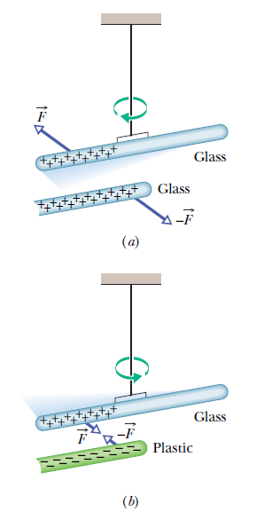

Slide 4
Electric Charge
In an atom, a positively charged nucleus is surrounded by electrons
The protons (+) in the nucleus attract the electrons (-), while the electrons repel each other

Slide 5
Atoms
All electrons are identical, with the same mass and same quantity of charge
The nucleus is composed of protons (all of which are also identical) and neutrons (neutral)
Atoms usually have as many electrons as protons, so the atom has a zero net charge

Slide 6
Ions
If a particle is removed from the atom, it becomes an ion
  Positive Ion: Has lost one or more electrons and has a net positive charge
  Negative Ion: Has gained one or more electrons and has a net negative charge

Slide 7
Removal of Electrons
The inner electrons are bound very tightly to the atom
The outermost electrons of many atoms are bound loosely and can be easily dislodged

Slide 8
Conductors
Materials which allow electric charge to flow freely
Metals are good conductors because their outer electrons are not bound tightly

Slide 9
Insulators
Materials which do not allow electric charge to flow freely (i.e. glass, rubber)

Slide 10
Semiconductor
Materials that can be made to behave as either a conductor or an insulator of electricity, i.e. germanium, silicon
Superconductor: Material that has infinite conductivity at low temperatures so that charge flows through it without resistance

